Slide 1

SharePoint Document Library - Part I
mintesnot

Slide 2

What is SharePoint Site Customization?

Slide 3
SharePoint Document Library
A Document Library is a storage location in SharePoint where users can:
Store files and documents
Organize business information
Share documents securely
Collaborate with teams
Track document changes
Unlike regular file storage, SharePoint document libraries provide advanced document management capabilities.
Examples of Files Stored: Word documents, Excel spreadsheets, PowerPoint presentations, PDF files, Images and videos & Contracts and reports.
Real Example
A university department can store:
Student Reports → Policies → Lecture Notes → Administrative Documents
inside one organized document library.

Slide 4
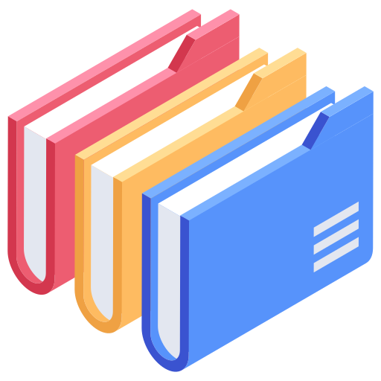
…
A SharePoint Document Library is a specialized container designed to store, organize, manage, and collaborate on documents within SharePoint.
It acts like a cloud-based smart folder system but with advanced capabilities such as:
✅ Version history ✅ Real-time collaboration ✅ Metadata management ✅ Permission control ✅ Approval workflows ✅ Search capabilities
Simple Explanation
Think of a document library as:
One Drive + Smart Folder + Team Collaboration + Document Tracking
Key Purpose
Centralize documents in one secure location for collaboration and management.

Slide 5
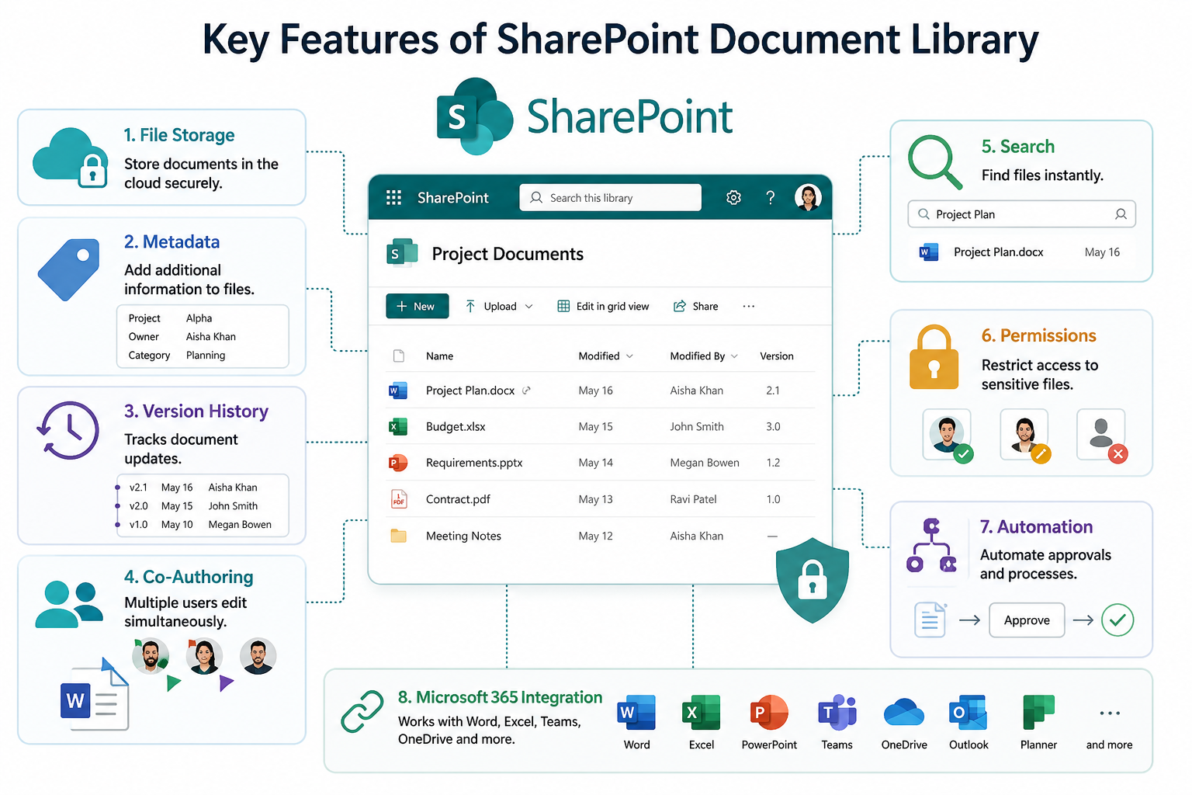
Key Features of SharePoint Document Library
File Storage – Store documents in the cloud securely.
Metadata – Add additional information to files.
Version History – Tracks document updates.
Co-Authoring – Multiple users edit simultaneously.
Search – Find files instantly.
Permissions – Restrict access to sensitive files.
Automaton – Automate approvals.
Microsoft 365 Integration – Works with Word, Excel, Teams, OneDrive…

Slide 6
Benefits of Document Libraires
Benefit | Description
Centralized Storage | Keep all files in one place
Collaboration | Multiple users work together
Security | Permission-based access
Version Control | Track document history
Fast Search | Quickly locate files
Accessibility | Access from anywhere
Without proper management
❌ Files become lost ❌ Duplicate versions appear ❌ Employees waste time searching ❌ Security risks increase

Slide 7
SharePoint List Vs. Document Library
Feature | SharePoint List | Document Library
Main Purpose | Store structured data | Store documents
Store Files | No | Yes
Metadata | Yes | Yes
Attachments | Limited | Full document storage
Collaboration | Limited | Advanced
Versioning | Available | Advanced
Office Integration | Minimal | Strong
Usage | For structured records | For managing files

Slide 8
…
Feature | SharePoint Lists | SharePoint Document Libraries
Primary Content | Non-document data (e.g., tasks, contacts) | Document files (e.g., Word, Excel, PDF)
Storage | Structured like a table with rows and columns | Structured as a folder hierarchy with files
Metadata | Customizable metadata for categorization | Metadata typically includes file properties
Versioning | Versioning tracks changes to list items | Versioning tracks changes to document files
Check-in/Check-out | Not typically used | Used to prevent simultaneous editing of documents
Permissions | Permissions can be set at list or item level | Permissions can be set at library or file level
Integration | Often used for task tracking, surveys, etc. | Used for document management, collaboration
Content Types | Supports content types for structured data | Supports content types for defining document templates
Template | Standard templates include tasks, calendars, etc. | Standard template for managing document files
Use Cases | Tracking issues, managing contacts, etc. | Storing organizing, and sharing document files

Slide 9
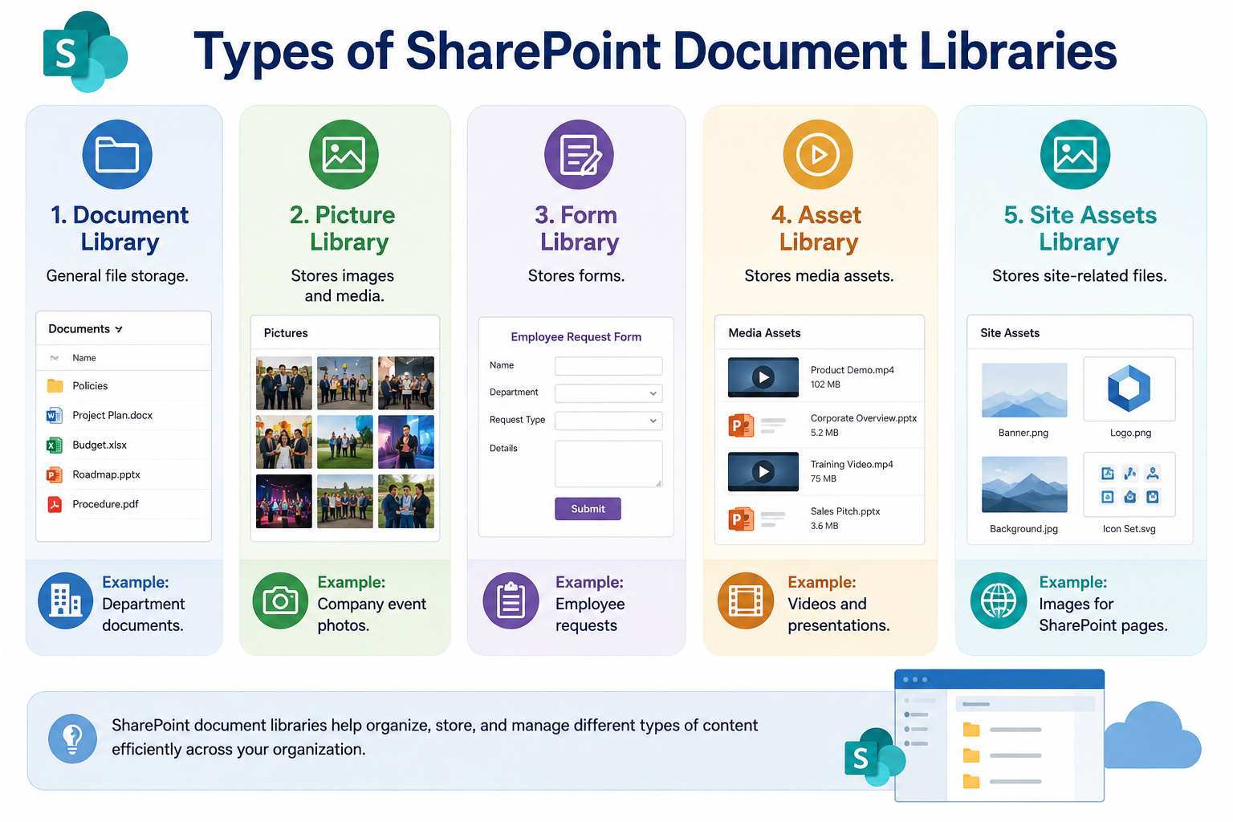
Types of Document Libraries
Document Library – General file storage. Example: Department documents.
Picture Library – Stores images and media. Example: Company event photos.
Form Library – Stores forms. Example: Employee requests
Assert Library – Stores media assets. Example: Videos and presentations.
Site Assets Library – Stores site-related files. Example: Images for SharePoint pages.

Slide 10
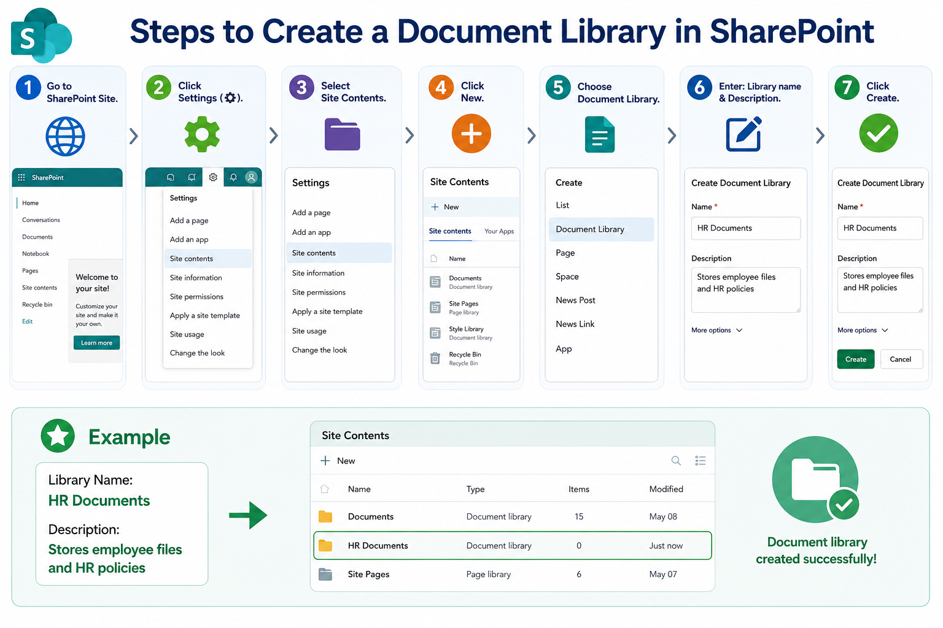
How to Create a Document Library
Step 1 – Go to SharePoint Site.
Step 2 – Click Settings (⚙️).
Step 3 – Select Site Contents.
Step 4 – Click New
Step 5 – Choose Document Library
Step 6 – Enter: Library name & Description
Step 7 – Click Create
Example
Library Name:
HR Documents
Description:
Stores employee files and HR policies

Slide 11
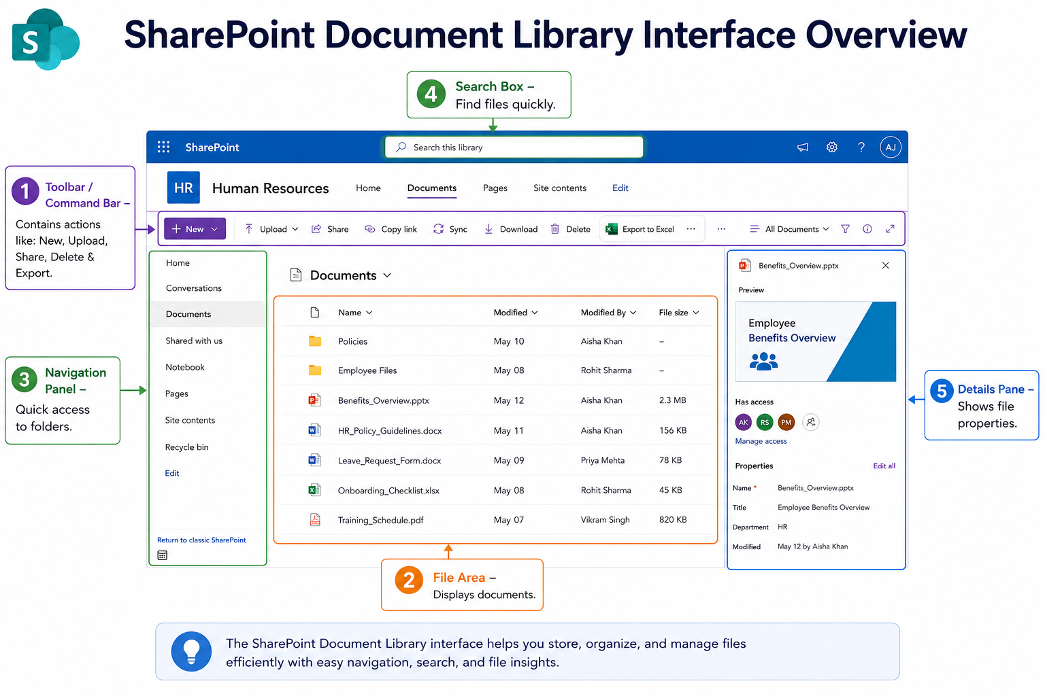

Document Library Interface Overview
Toolbar / Command Bar – Contains actions like: New, Upload, Share, Delete & Export.
File Area – Displays documents.
Navigation Panel – Quick access to folders.
Search Box – Find files quickly.
Details Pane – Shows file properties.

Slide 12
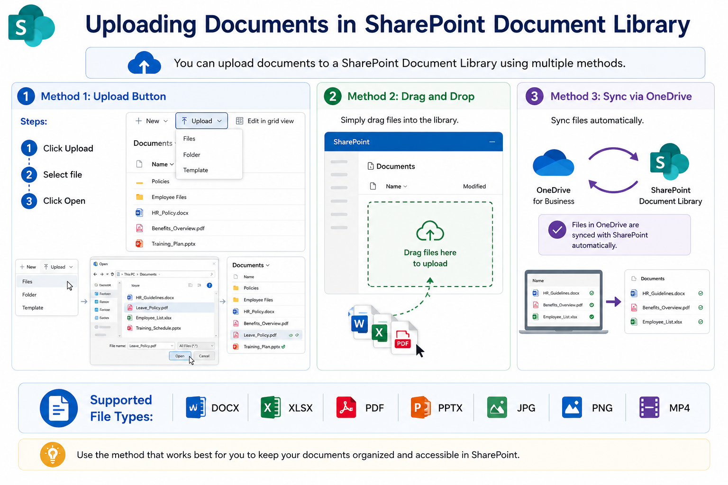
Uploading Documents
Method 1: Upload Button
Steps:
Click Upload
Select file
Click Open
Method 2: Drag and Drop
Simply drag files into library.
Method 3: Sync via OneDrive
Sync files automatically.
Supported File Types: DOCX, XLSX, PDF, PPTX, JPG, PNG, MP4.

Slide 13
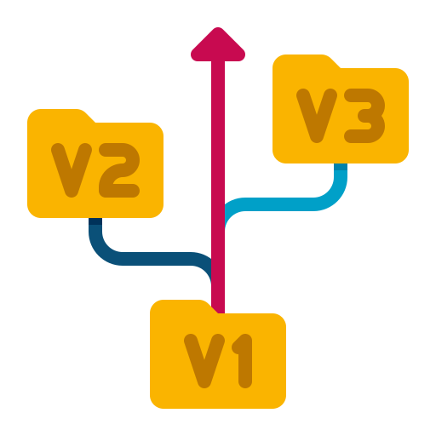
Document Versioning
Versioning is a feature in SharePoint that keeps track of document changes over time.
Whenever a file is edited, SharePoint saves a new version instead of replacing the original document permanently.
This allows users to:
View document history
Restore previous versions
Track edits
Prevent accidental data loss
Without versioning:
❌ Mistakes may become permanent ❌ Deleted content is difficult to recover
With versioning:
✅ Older copies remain available

Slide 14
Types of Versioning
Major Versions | Minor Versions (Drafts)
Major versions are official published versions. Example : 1.0 -> 2.0 -> 3.0 -> 4.0 Used for: Final reports Approved documents Published content | Minor versions are draft copies. Example: 1.0 -> 1.1 -> 1.2 -> 1.3 -> 2.0 Used for: Work in progress Internal reviews

Slide 15
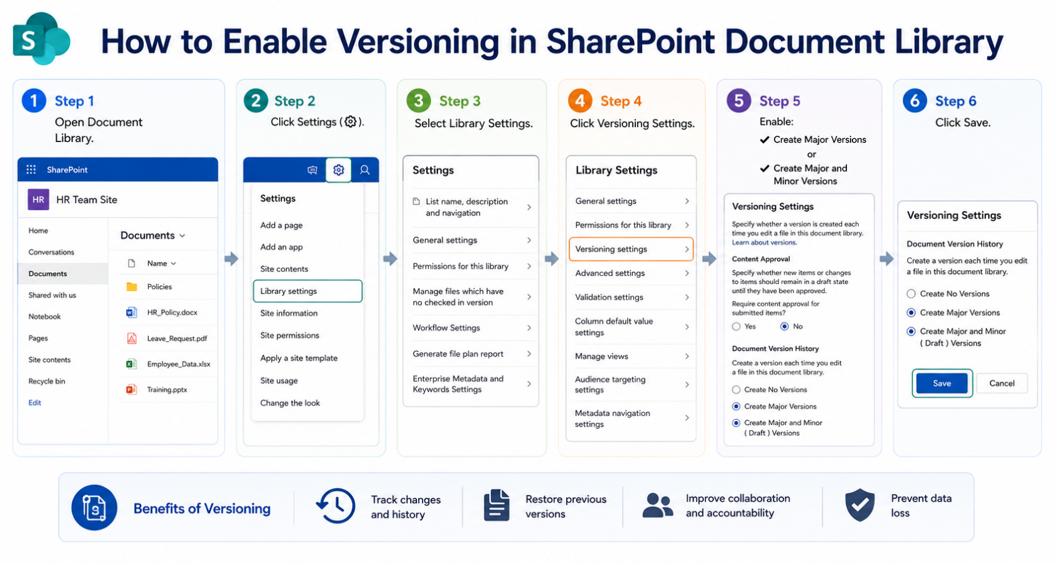
How to Enable Versioning
Step 1 – Open Document Library.
Step 2 – Click Settings (⚙️).
Step 3 – Select Library Settings.
Step 4 – Click Versioning Settings.
Step 5 – Enable:
✔ Create Major Versions
or
✔ Create Major and Minor Versions
Step 6 – Click Save
Benefits of Versioning
✅ Prevents accidental overwriting ✅ Keeps document history ✅ Makes auditing easier ✅ Supports compliance requirements

Slide 16


Check-In and Check-Out
Check-In & Check-Out is a feature that prevents multiple users from editing the same file at the same time.
It temporarily locks a document for editing.
Check-Out
When a document is checked out:
Only one person edits it
Others can view but cannot edit
A lock icon appears
Check-In
After editing the user checks in the document:
Save changes
Unlocks file
Creates new version

Slide 17
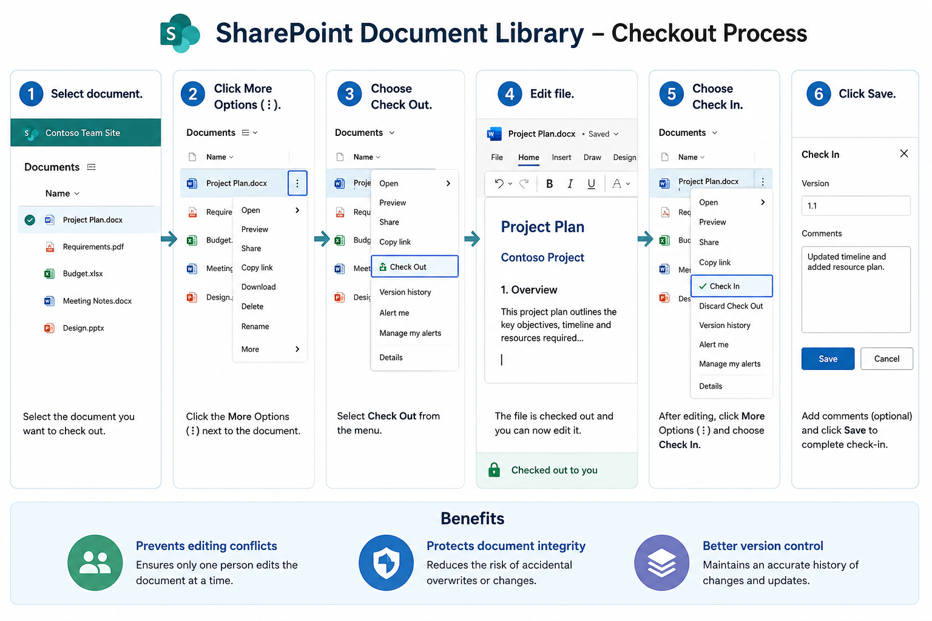
Steps to Check Out a Document
Step 1 – Select document.
Step 2 – Click More Options (⋮).
Step 3 – Choose Check Out.
Step 4 – Edit file.
Step 5 – Choose Check In
Step 6 – Click Save
Benefits
✅ Prevents editing conflicts ✅ Protects document integrity ✅ Better version control

Slide 18
Co-Authoring (Real-Time Collaboration)
Co-authoring allows multiple users to edit the same document simultaneously.
Users can collaborate in real time.
Supported in Word, Excel & PowerPoint through Microsoft 365.
When teams edits at the same time; SharePoint shows: Who is editing, Cursor position & Changes instantly.
Requirements for Co-Authoring
✔ SharePoint Online
✔ Microsoft 365 Apps
✔ Permission to edit
Benefits
✅ Faster teamwork ✅ No duplicate files ✅ Live collaboration ✅ Automatic saving

Slide 19
Traditional Editing Vs Co-Authoring
Traditional Editing | Co-Authoring
Email attachments | One shared file
Multiple copies | Single document
Slow collaboration | Instant editing
Version confusion | Real-time updates

Slide 20
Co-Authoring Vs Check-Out
Feature | Co-Authoring | Check-Out
Multiple Editors | Yes | No
Real-Time Editing | Yes | No
File Locking | No | Yes
Best For | Team collaboration | Sensitive documents

